Slide 1
Azure Monitoring Deep Dive Updated 5 Feb 2020

Slide 2
AMDD > Agenda
Big picture
Basics
Metrics
Alerts
Q&A
Logs

Slide 3

AMDD > Big Picture

Slide 4
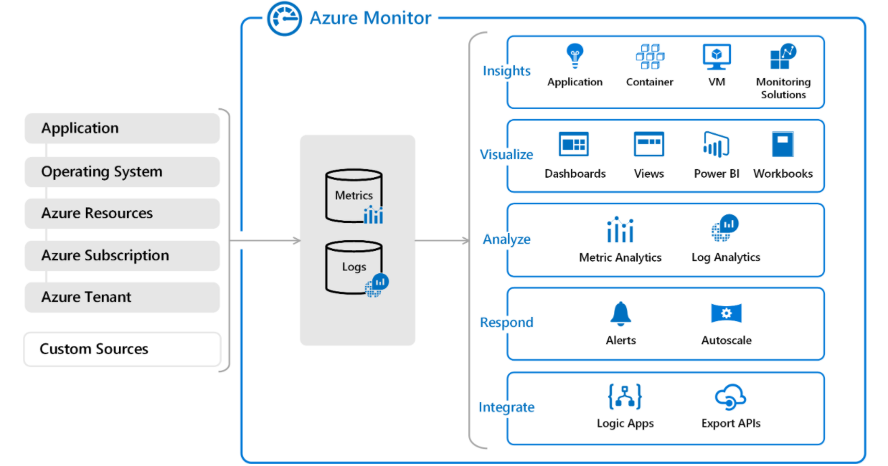
AMDD > Big Picture > Azure Monitor
Azure Monitor
data sources
Azure Monitor services
Azure Monitor Log Analytics workspace

Slide 5

AMDD > Big Picture > Application Insights
Solutions instrumented via Application Insights SDK(s)
Integration Services
Azure Application Insights Resource in Azure

Slide 6
AMDD > Big Picture > Application Insights > Application Maps

Slide 7
AMDD > Big Picture > Application Insights > Dependencies

Slide 8

AMDD > Big Picture > Demo

Slide 9

Azure Monitor > Basics

Slide 10

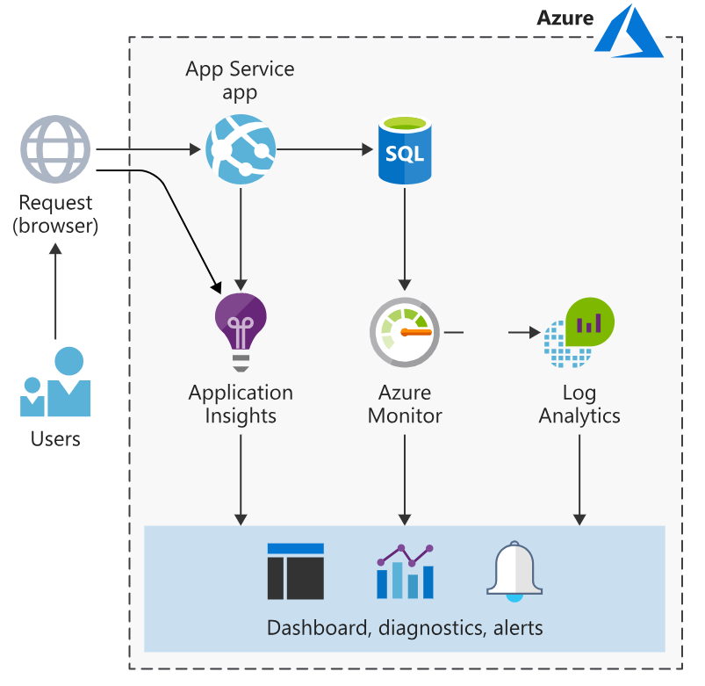
Azure Monitor > Basics > Taxonomy
Agents - are programs designed to ship metrics & logs to Azure Monitor.
Data sources – are processes sending metric & log data via agents and/or SDKs.
Resources – are services created in Azure that are observed by Azure Monitor.
Workspaces – are storage units for metrics & logs.
SDKs – are libraries used to control instrument of your distributed tracing.
Services – Integration services provided by Azure Monitor.

Slide 11
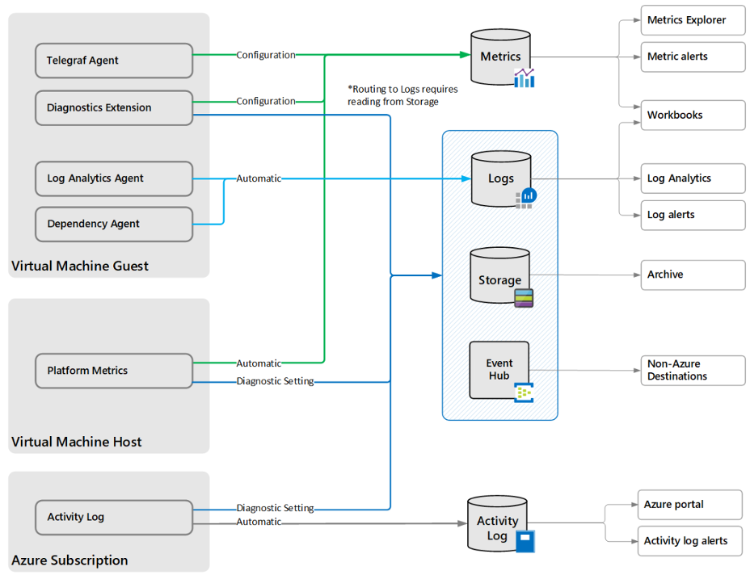
Azure Monitor > Basics > Agents
Log Analytics Agent - targets OS & VMs in Azure, other cloud providers, and on-premises machines.
Azure Diagnostics Extension – targets OS & workloads of VMs and other compute resources.
Telegraf Agent - targets Linux computers.
Azure Monitor Agent – replaces the above from 2024+
Dependency Agent - targets processes running on the machine and external process dependencies.

Slide 12
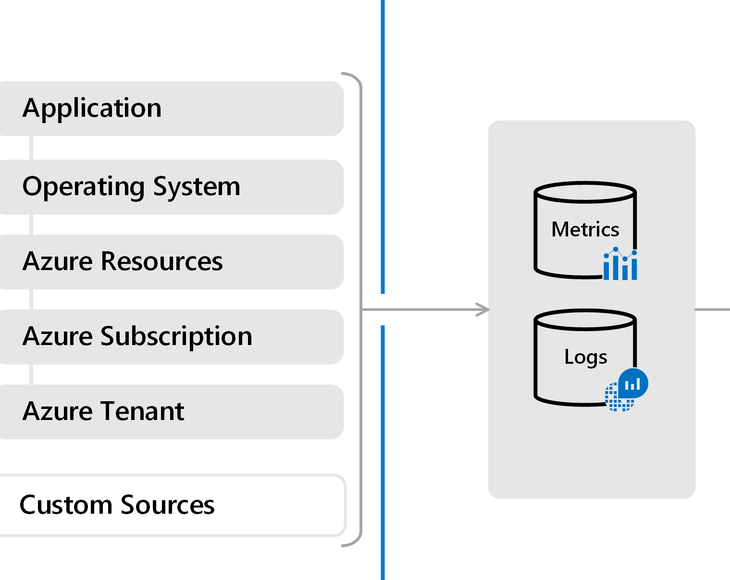
Azure Monitor > Basics > Data Sources (tiers)
Application – Data from SDK-enabled processes.
OS – Data from OSs orchestrated by Azure.
Resource - Data about the operation and performance of Azure resources (SaaS/PaaS).
Subscription - Data related to the health and management of cross-resource services, e.g. Resource Manager and Service Health.
Tenant - Data about the operation of tenant-level Azure services, e.g. Azure AD.
Custom – Everything else.

Slide 13
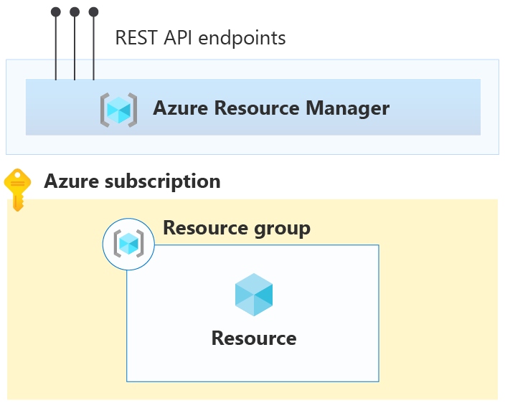
Azure Monitor > Basics > Resources
Activity log - Subscription level events that track operations for each Azure resource.
Platform metrics - Numerical values that are automatically collected at regular intervals and describe some aspect of a resource at a particular time.
Resource logs - Provide insight into operations that were performed by an Azure resource, for example getting a secret from a Key Vault or making a request to a database.

Slide 14
Azure Monitor > Basics > Workspaces
Are the logical storage unit where data is collected and stored.
Contain two databases: logs & metrics.
Supports extensible dashboards & widget configurations to visualize data.
Uses Kusto Query Language (KQL) to query databases.

Slide 15
Azure Monitor > Basics > SDKs
ASP.NET
ASP.NET Core
NodeJS
JavaScript
App Center (mobile SDK)

Slide 16
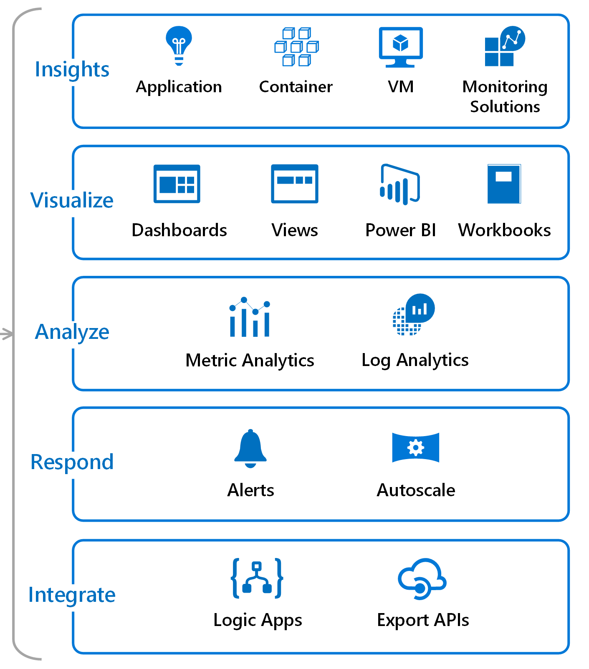
Azure Monitor > Basics > Services
Insights - services responsible for capturing application logs & metrics.
Visualize - services used to visualize data.
Analyze – services available for analyzing data.
Respond – services focused on responding to patterns identified in the data.
Integrate – services related to integrating Azure Monitor with third parties.

Slide 17

Azure Monitor > Basics > Hands-on

Slide 18

Azure Monitor > Basics > Code Kata #1
Notes:
https://www.serverless360.com/blog/azure-log-analytics-workspace (setup workspace)
Create a dashboard with standard CPU metrics
Create simple .net app w. instrumentation

Slide 19

Azure Monitor > Basics > Q/A

Slide 20
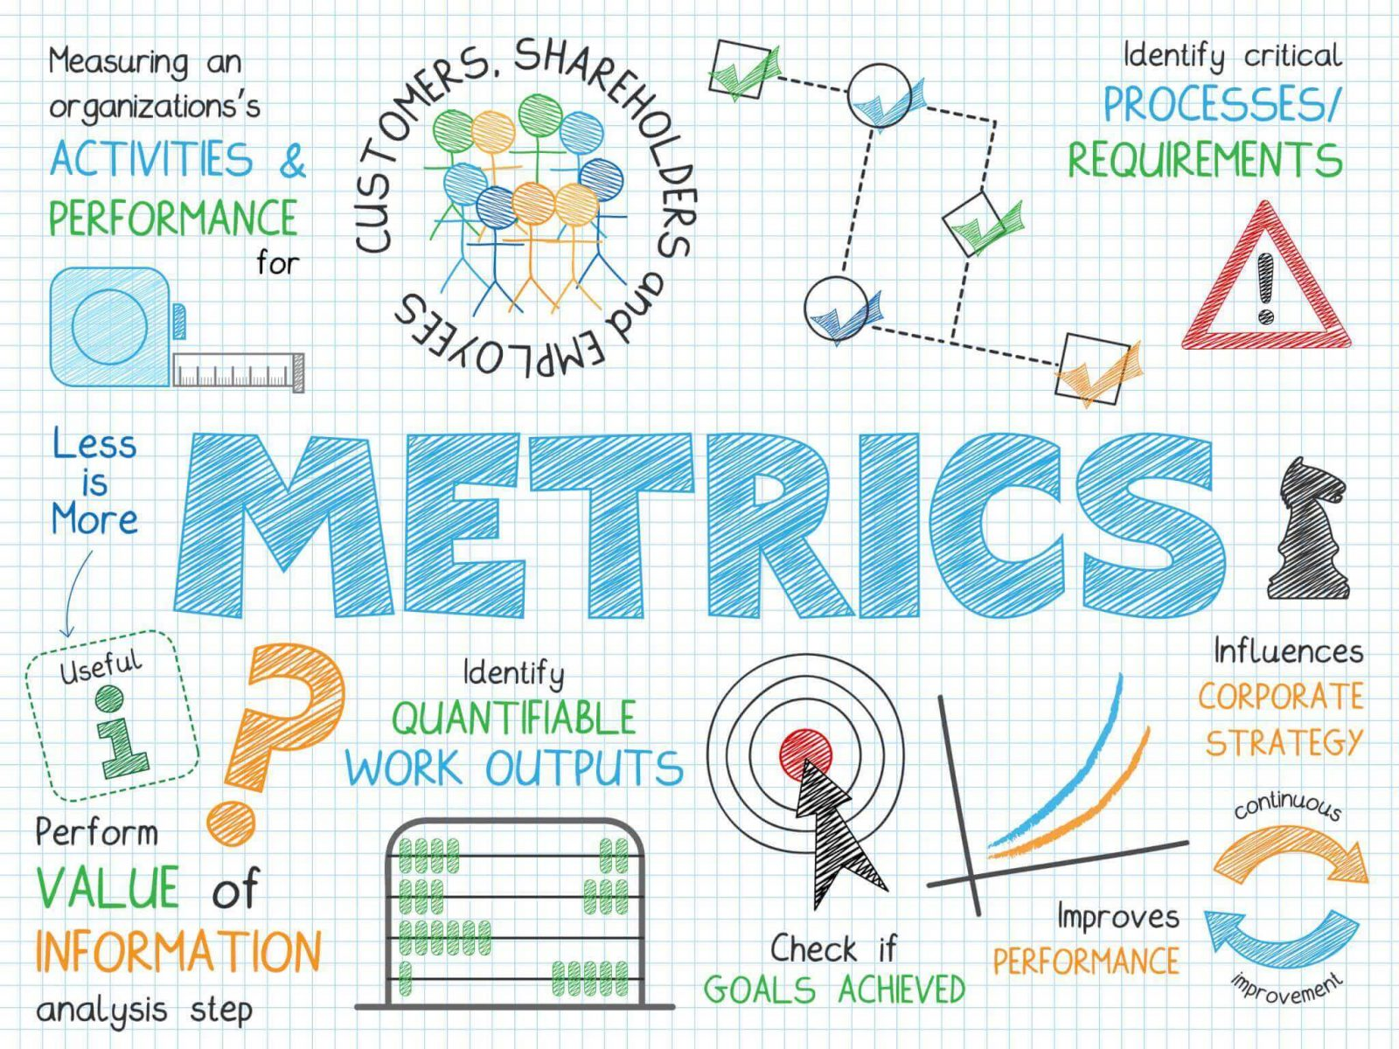
Azure Monitor > Metrics

Slide 21
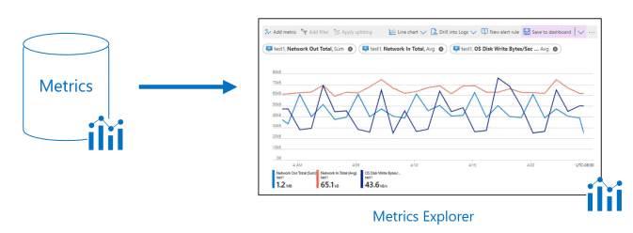
Azure Monitor > Metrics > Metric Explorer
Provides an easy-to-use editor for querying metrics data.
Allows plotting charts, visually correlating trends, and investigating spikes & dips in metrics values.
Support filtering and splitting which are powerful diagnostic tools for metrics with dimensions.

Slide 22
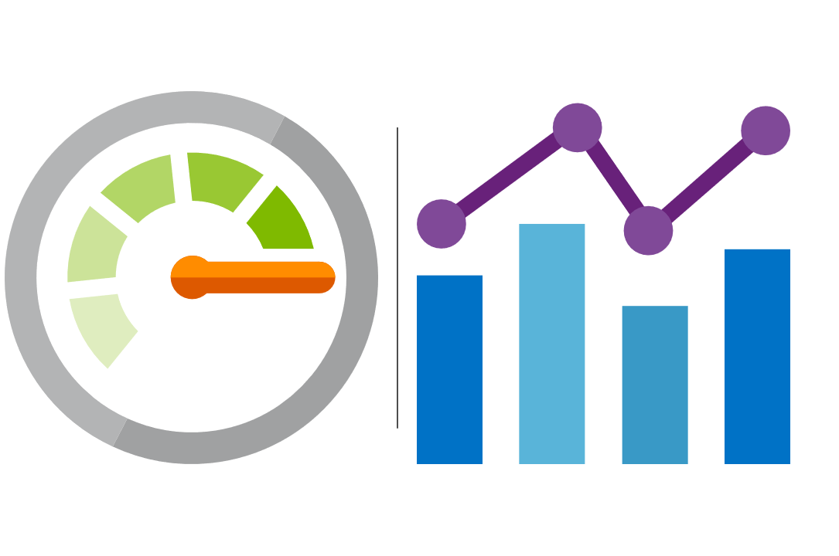
Azure Monitor > Metrics > Guidelines
Must be simple, objective and hard to misinterpret.
Collection should be automated and non-intrusive.
Contributes to quality assessment in the software development lifecycle.
Support RED-metrics when possible (Request Rate, Request Errors & Request Duration).

Slide 23
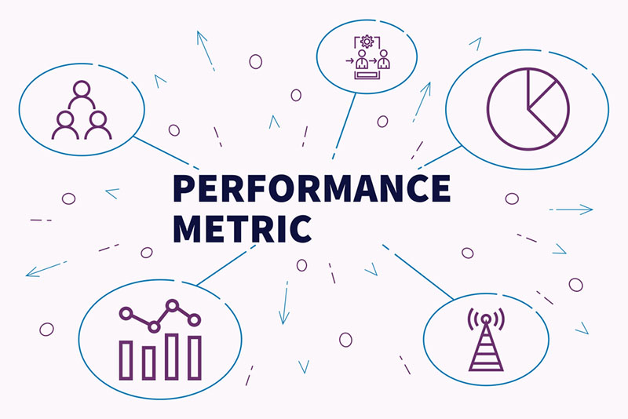
Azure Monitor > Metrics > Types
Log-based (Standard) - available by default in Azure Monitor.
Log-based (Custom) - created on demand via Application Insight SDKs or REST API.
Multi-dimensional - dimensions are name/value pairs that carry additional data to describe the metric value.
Pre-aggregated - are stored as pre-aggregated time series, and only with key dimensions, which makes them superior at query time.

Slide 24
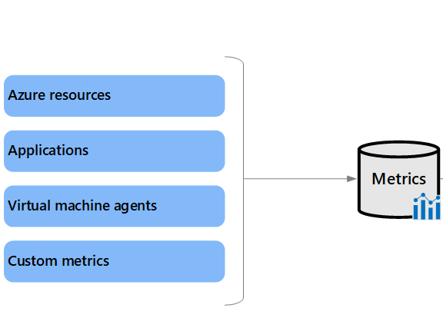
Azure Monitor > Metrics > Source
Azure resources - platform metrics provide visibility into resource health and performance.
Applications Insights - help you detect performance issues and track trends.
Virtual machine agents - collect metrics from the guest operating system of a virtual machine.
Custom metrics - extends the standard metrics that are automatically available in Azure Monitor.

Slide 25
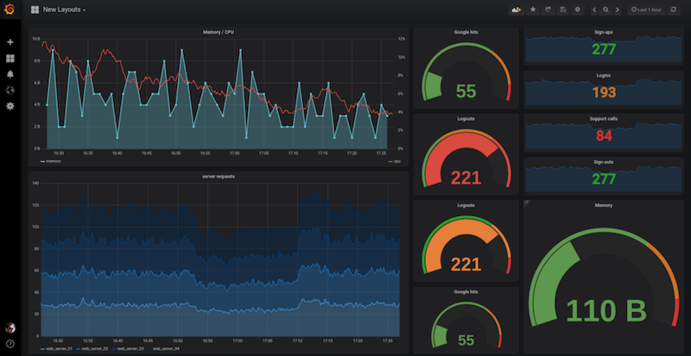
Azure Monitor > Metrics > Quotas and limits
Total active time series in a subscription (across all regions): 50,000
Dimension keys per metric: 10
String length for metric namespaces, metric names, dimension keys, and dimension values: 256 characters

Slide 26
Azure Monitor > Metrics > Hands-on

Slide 27
Azure Monitor > Metrics > Code Kata #2
Notes:
Create custom metrics in .NET app via NuGet package
Setup a simple alert in Azure Monitor based on metrics to send email

Slide 28
Azure Monitor > Metrics > Q/A

Slide 29

Azure Monitor > Logs

Slide 30
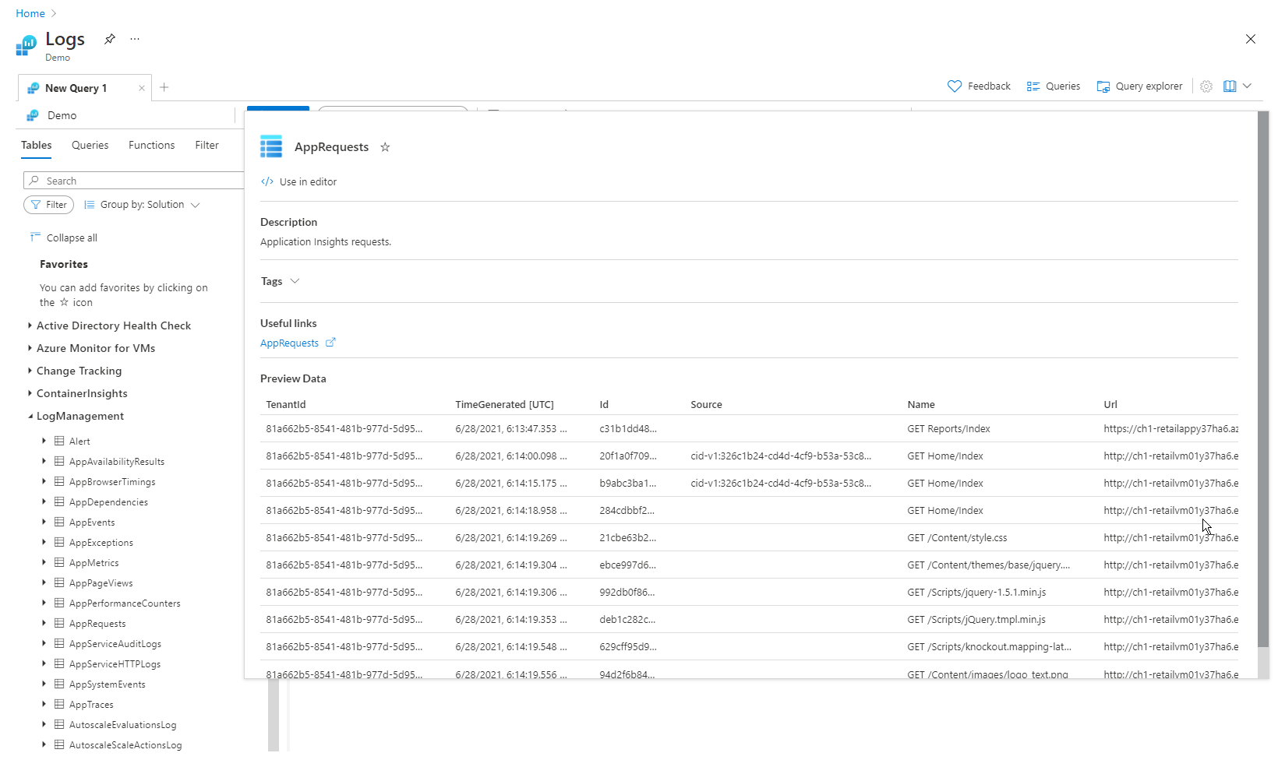
Azure Monitor > Logs > Log Analytics
[TODO]

Slide 31
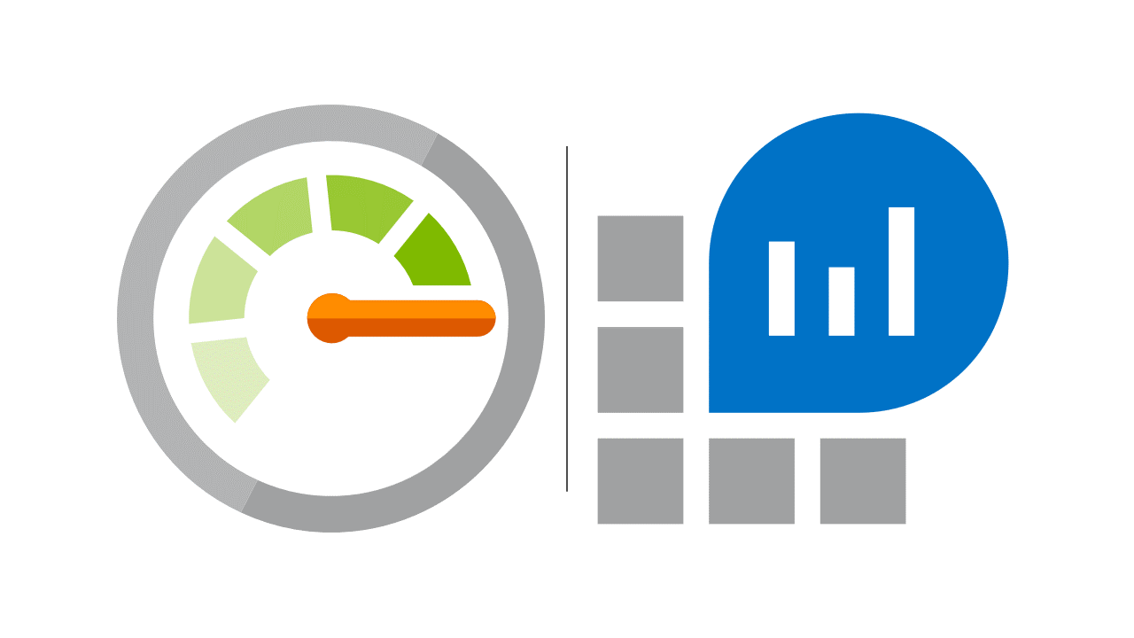
Azure Monitor > Logs > Guidelines
[TODO]

Slide 32
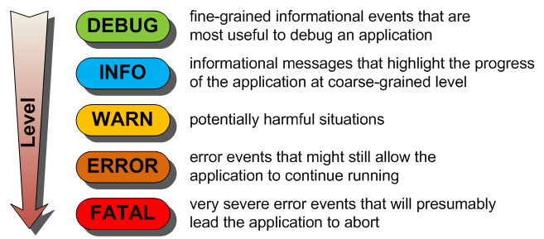
Azure Monitor > Logs > Log Levels
[TODO]

Slide 33
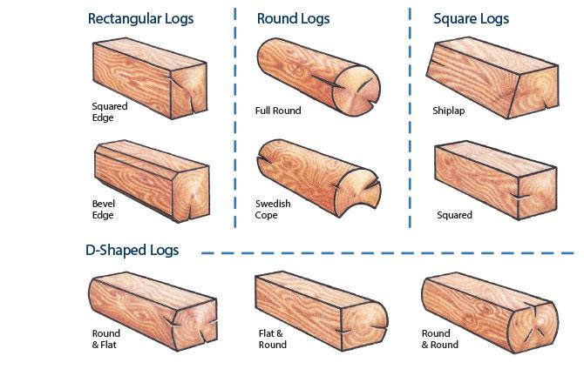
Azure Monitor > Logs > Log Types
[TODO]

Slide 34
Azure Monitor > Logs > Hands-on

Slide 35
Azure Monitor > Logs > Code Kata #3
Notes:
Configure ApplicationInsights Serilog sink
Create a few trace logs
Setup a dashboard to visualize new trace logs

Slide 36
Azure Monitor > Logs > Q/A

Slide 37

Azure Monitor > Alerts

Slide 38

Azure Monitor > Alert > Guidelines
[TODO]

Slide 39
Azure Monitor > Alert > Types
[TODO]

Slide 40
Azure Monitor > Alerts > Smart Groups
[TODO]

Slide 41
Azure Monitor > Alerts > Hands-on

Slide 42
Azure Monitor > Alerts > Code Kata #3
Notes:
Setup some advanced alerts in Azure Monitor based on metrics

Slide 43
Azure Monitor > Alerts > Q/A

Slide 44
Azure Monitor > Feedback
https://forms.office.com/Pages/ResponsePage.aspx?id=ZpSpcwWtIUKfkOcUKqL2wTFclz-gNvpNq3THAj1j3ZxUODk1TjlEWVNJNzUxNjAwTFhGQkQ2VkNTWi4u

Slide 45
Azure Monitor > Literature
https://docs.microsoft.com/en-us/azure/azure-monitor/overview
https://docs.microsoft.com/en-us/learn/modules/azure-monitor/
https://docs.microsoft.com/en-us/learn/modules/design-solution-to-log-monitor-azure-resources/
https://docs.microsoft.com/en-us/learn/modules/analyze-infrastructure-with-azure-monitor-logs/
https://docs.microsoft.com/en-us/learn/modules/monitor-app-performance/
https://docs.microsoft.com/en-us/learn/modules/microservices-logging-aspnet-core/

